Slide 1
Office 365 Development

Slide 2
Deep Dive into the Office 365 Video API

Slide 3
Developer vision
USERS
DATA
HTML

Slide 4

Agenda
Introducing Video Portal
Using the Office 365 Video API

Slide 5
Gartner “projects that, by 2016, large companies will stream more than 16 hours of video per worker, per month”
Gartner Magic Quadrant for Enterprise Video Content Management, Whit Andrews, September 2013

Slide 6

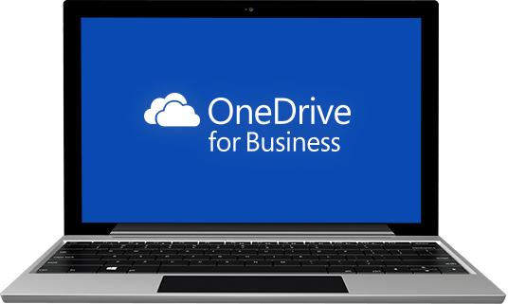
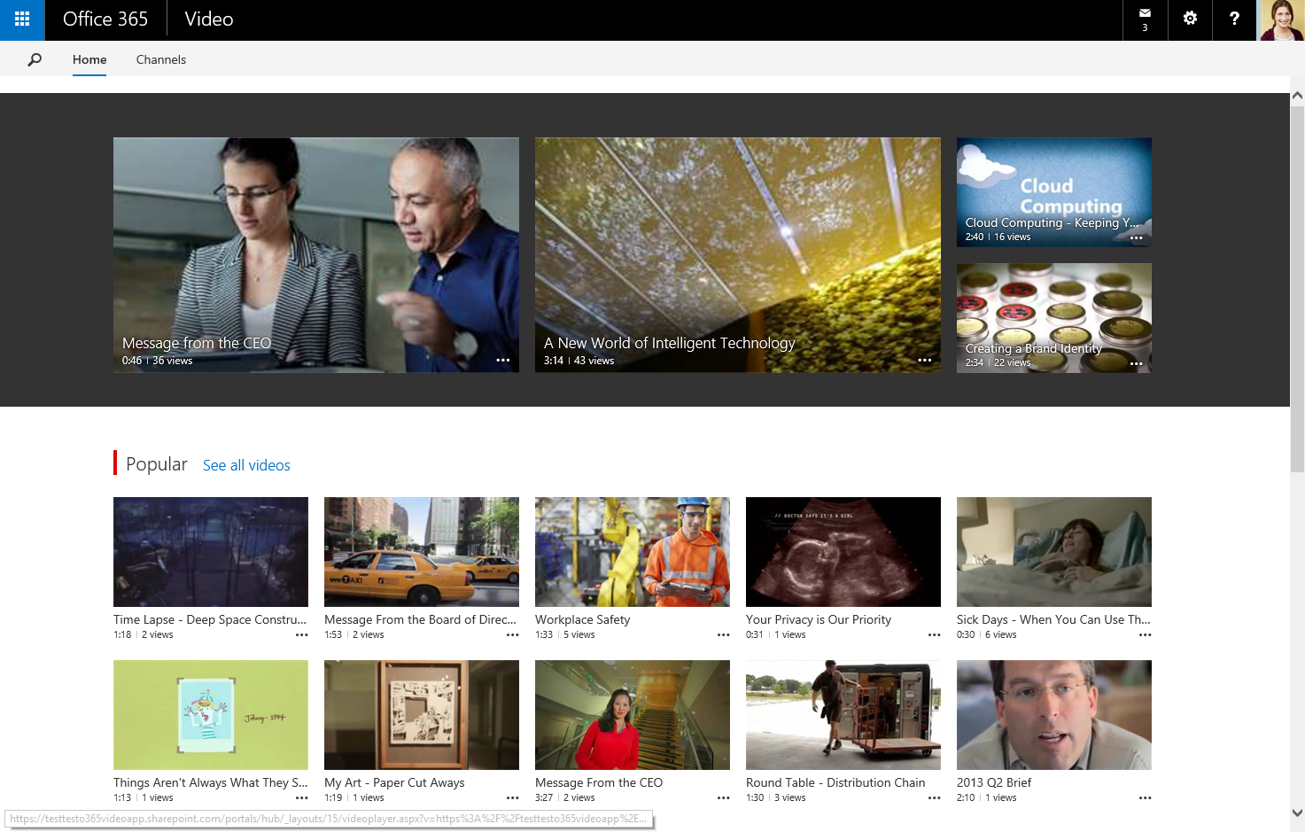
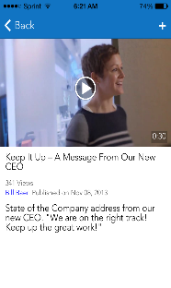
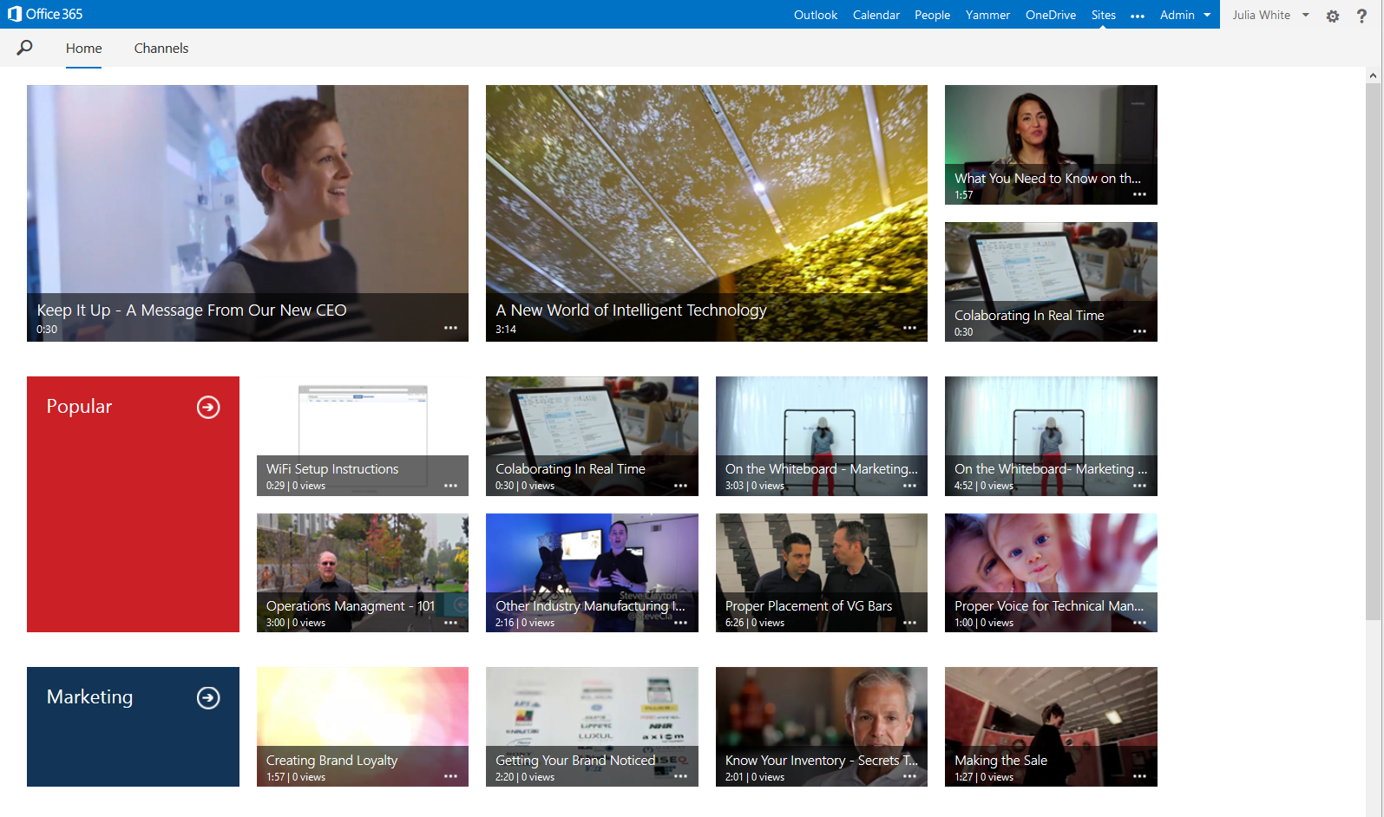
Office 365 Video Portal
simple | fast | mobile | secure
easily consume video
modern, mobile, “everything in one place” video destination
share ideas broadly
rich, discoverable social video across devices
secure & easy to manage
scalable, encrypted, cross-geo video streaming service

Slide 7
Key Uses
Training
Corporate Messages
Community
Help & How To

Slide 8
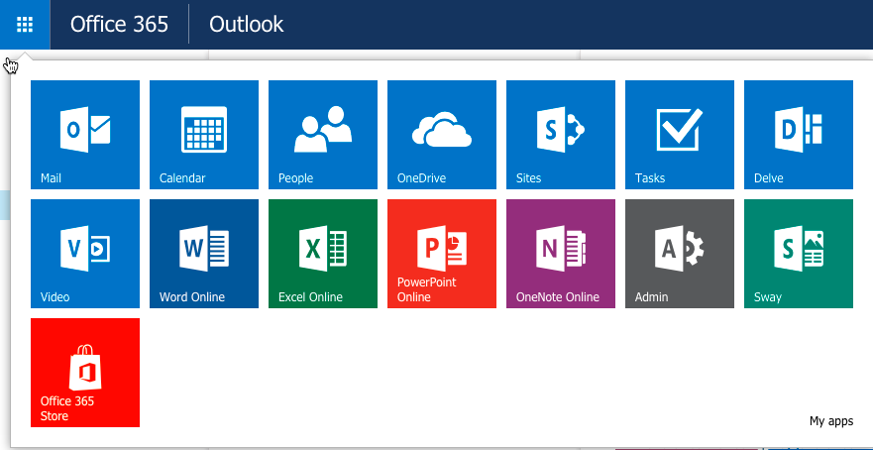

Slide 9
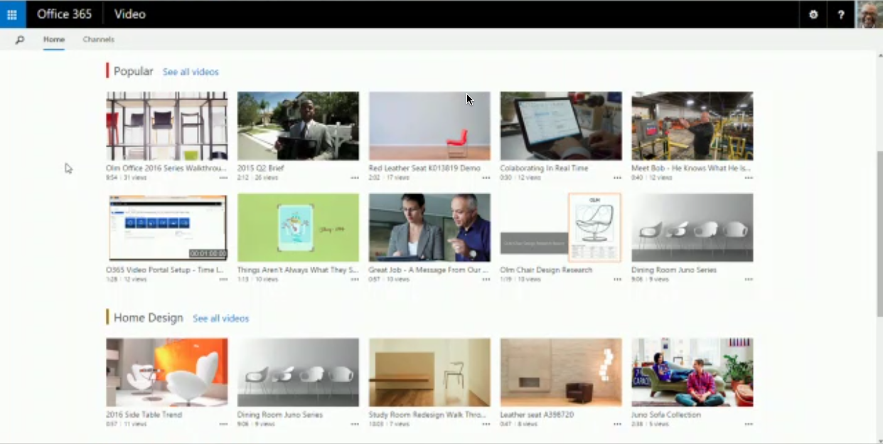

Slide 10
Powered by SharePoint Online & Azure Media Services
SharePoint Online
Content Storage
Metadata
Security & Compliance
Search
Azure Media Services
Transcoding
Adaptive Streaming
Secure Delivery
Thumbnails

Slide 11
Current Video Portal Capabilities
HTML5 mobile playback in browser– Windows, Android and iOS
Responsive player playback page
Office 365 for iPhone app
Built-in CDN – Better playback performance across geographic locations
More granular permissions per channel– Owners / Editors / Viewers
Related videos powered by the Office Graph
REST APIs for Office 365 Video [in preview]

Slide 12
Future Video Portal Capabilities
Embed into other Office 365 locations outside of the video portal
Responsive design for all video portal pages
More personalized Home page powered by the Office Graph
Hybrid link to Office 365 Video from SharePoint Server 2016
“Publish to” from Skype for Business into an Office 365 Video channel

Slide 13
demo
Exploring the Office 365 Video Portal

Slide 14
Office 365 Video API

Slide 15
Introducing the Video API
Discover & interact with videos in the Office 365 Video Portal
Provides access to:
Video Portal
Channels
Videos
Video REST API Currently in Preview
Some things may change, added & removed

Slide 16
Video Portal Operations
// get the Video Portal API endpoint
// requires HTTP Authorization header
// for authentication
HTTP GET
https://<tenant>.sharepoint.com/
_api/VideoService.Discover

Slide 17
Channel Operations
List all channels user can view & edit
HTTP GET: [..]/_api/VideoService/Channels
HTTP GET: [..]/_api/VideoService/CanEditChannels
Details on a specific channel
HTTP GET: [..]/_api/VideoService/Channels(‘<guid>’)
All videos in a channel
HTTP GET: [..]/_api/VideoService/Channels(‘<guid>’)/Videos

Slide 18
demo
Video API – Working with Channels

Slide 19
Video Operations
Details on a video
HTTP GET: [..]/_api/VideoService/Channels(‘<guid>’)/Videos(‘<guid>’)
Details on playing a video
HTTP GET: [..]/_api/VideoService/Channels(‘<guid>’)/Videos(‘<guid>’)/GetPlaybackUrl(‘<playbacktype>’)
// Playback type 0 = smooth streaming / MPEG-DASH
// Playback type 1 = HLS streaming

Slide 20
demo
Video API – Working with Videos

Slide 21
Managing Videos
Creating videos
First create placeholder – does not include the file
Then upload the file
Upload in a single upload (ideal for small videos)
Upload in chunks to avoid timeouts (suited for large videos)
Update video metadata
Delete videos

Slide 22
demo
Video API – Managing Videos

Slide 23
Summary
Introducing Video Portal
Video API

Slide 24
Developer Program Launch
1 YEAR FREE
E-mail Newsletters
Free Developer Subscription
Free Training
Free Tools
Webinars
http://dev.office.com/devprogram

Slide 25


Engage
Office 365 Network
https://www.yammer.com/itpronetwork
Twitter
S
S
t
t
a
a
r
r
t
t
@OfficeDev
Stack overflow
[ms-office]
Channel 9 Dev Show
http://aka.ms/O365DevShow
Podcasts http://dev.office.com/podcasts
Snack Demos
http://aka.ms/o365DevSnackDemos
UserVoice
http://officespdev.uservoice.com/

